Slide 1
UNDERSTANDING WEB HOSTING
An Overview of Web hosting Static​ File in IBM Cloud​
Aashika Raj

Slide 2
Content
Problem Statement
Project Overview
Why we need this?
How it will help?
Solution
How it’s Unique
Modelling
Analysis Dashboard
Result

Slide 3
PROBLEM STATEMENT
Increasing Demand for Scalability
Security Concerns
Diverse Hosting Needs
Balancing Performance and Cost
Complexity in Technical Management
Uptime and Reliability Challenges
Lack of Transparent Information

Slide 4
PROJECT OVERVIEW
Enhance website performance and responsiveness.
Improve security measures to safeguard against cyber threats.
Implement scalable hosting architecture to accommodate future growth.
Ensure high uptime and reliability for uninterrupted services.
Provide cost-effective hosting solutions without compromising quality.
Hosting Solutions for Multiple Websites and Applications
Integration of Security Protocols (SSL, Firewalls)
Implementation of Scalable Infrastructure
User-Friendly Control Panel for Easy Management
Ongoing Monitoring and Maintenance
Businesses of all sizes seeking reliable web hosting solutions.
Individuals and organizations with diverse hosting needs.
E-commerce platforms, blogs, and content-heavy websites.

Slide 5
WHY WE NEED THIS?
Web hosting is crucial for anyone looking to establish an online presence. It provides the necessary infrastructure, resources, and services to make your website accessible, secure, and functional on the internet.

Slide 6
HOW WILL IT HELP PEOPLE?
Regular Backups
Software Updates
Monitoring Website Performance
Budgeting for Hosting Services

Slide 7
SOLUTION
hosting services offer a range of solutions tailored to provide optimal performance, security, and scalability for your unique web requirements

Slide 8
HOW ITS UNIQUE
The uniqueness of web hosting lies in its ability to provide a tailored infrastructure that supports the diverse needs of websites, ensuring accessibility, security, and scalability in a cost-effective manner.

Slide 9
MODELLING
we've visualized the key components of a web hosting infrastructure. It illustrates how hosting servers, plans, security measures, and support systems work together to create a robust environment for hosting websites effectively."
Feel free to use visual elements, such as icons or illustrations, to enhance the clarity and engagement of your PowerPoint presentation on web hosting modeling.

Slide 10
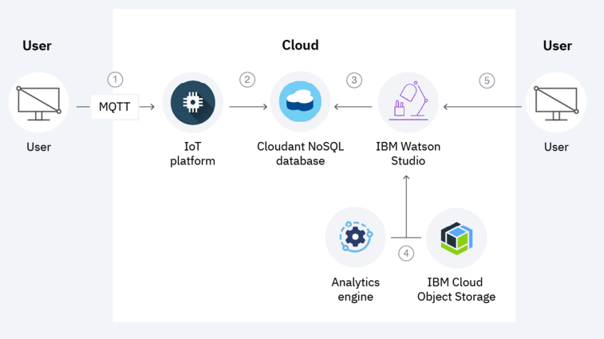
DEMO – ANALYSIS DASHBOARD

Slide 11
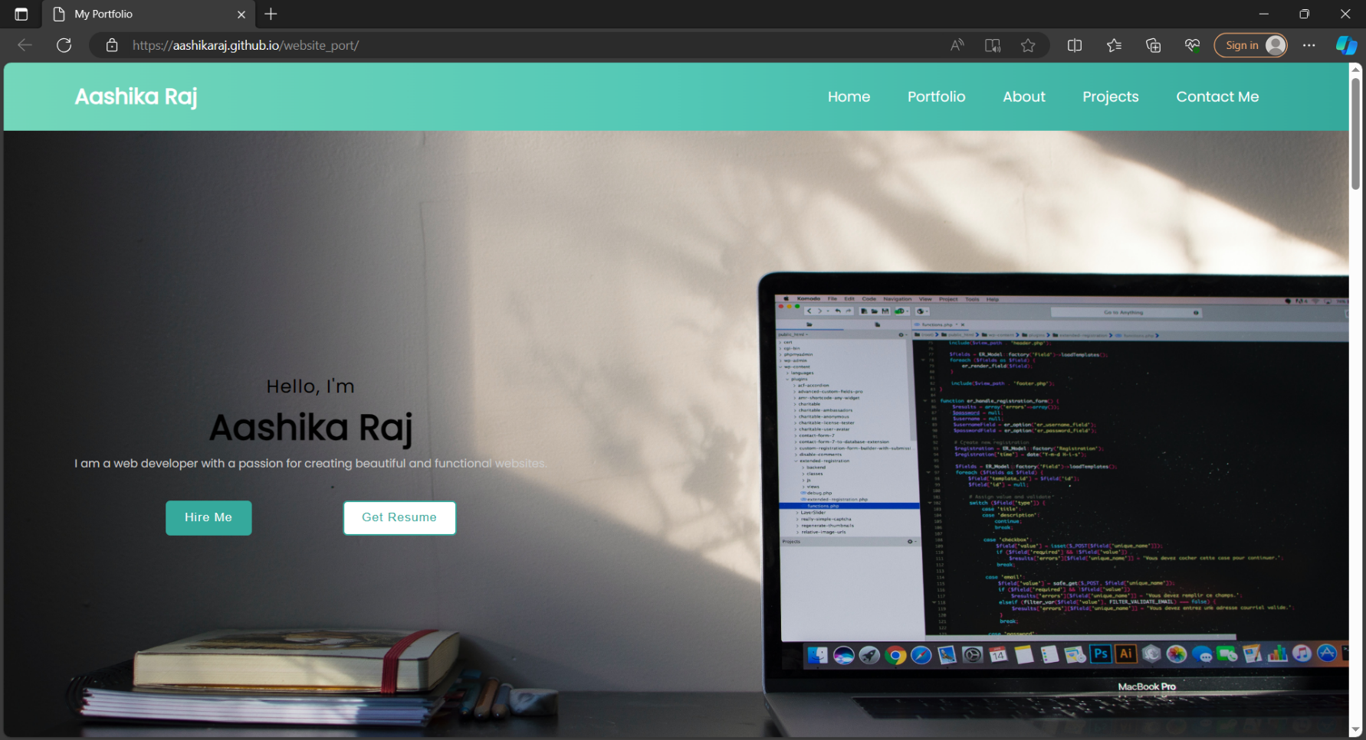
RESULT

Slide 12
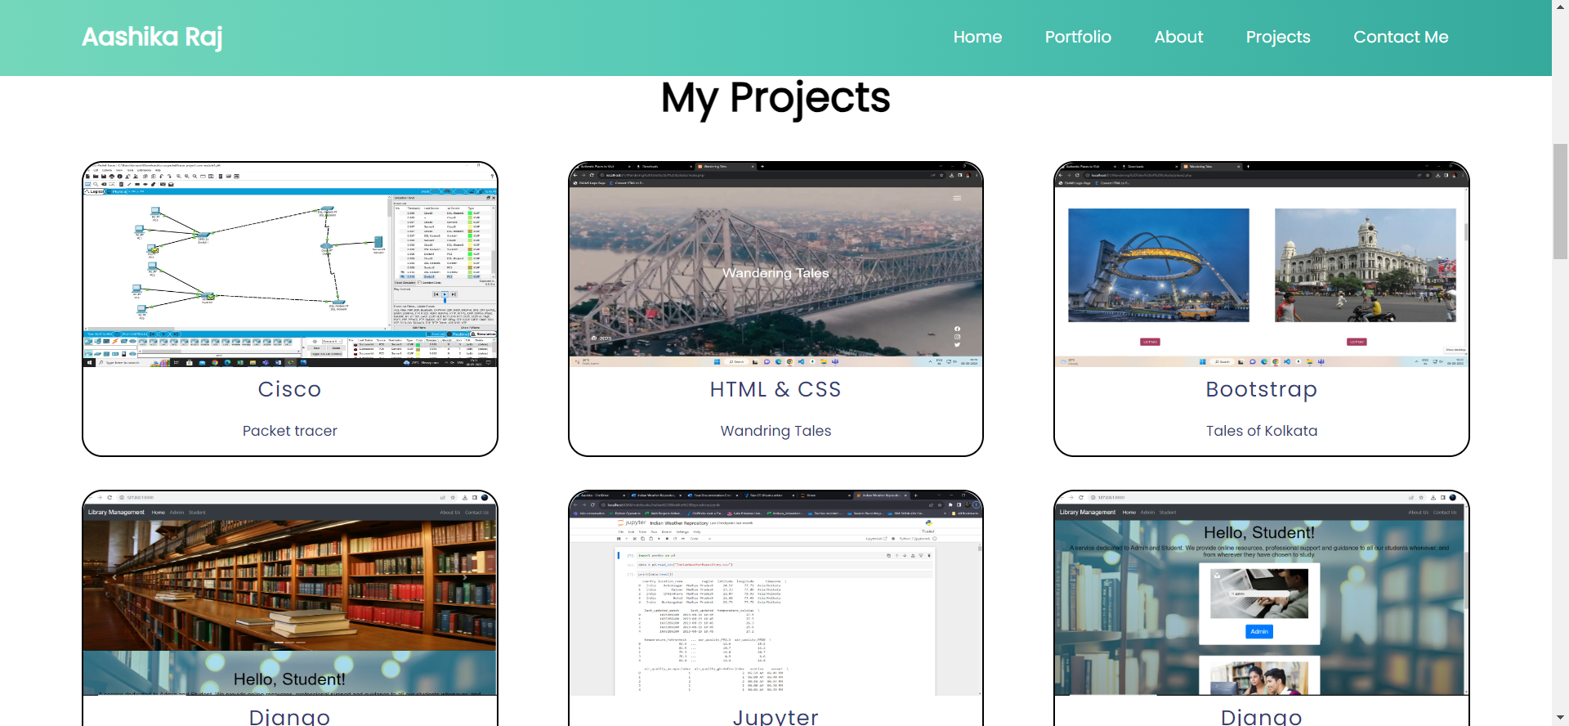
RESULT

Slide 13
THANK YOU

